Slide 1
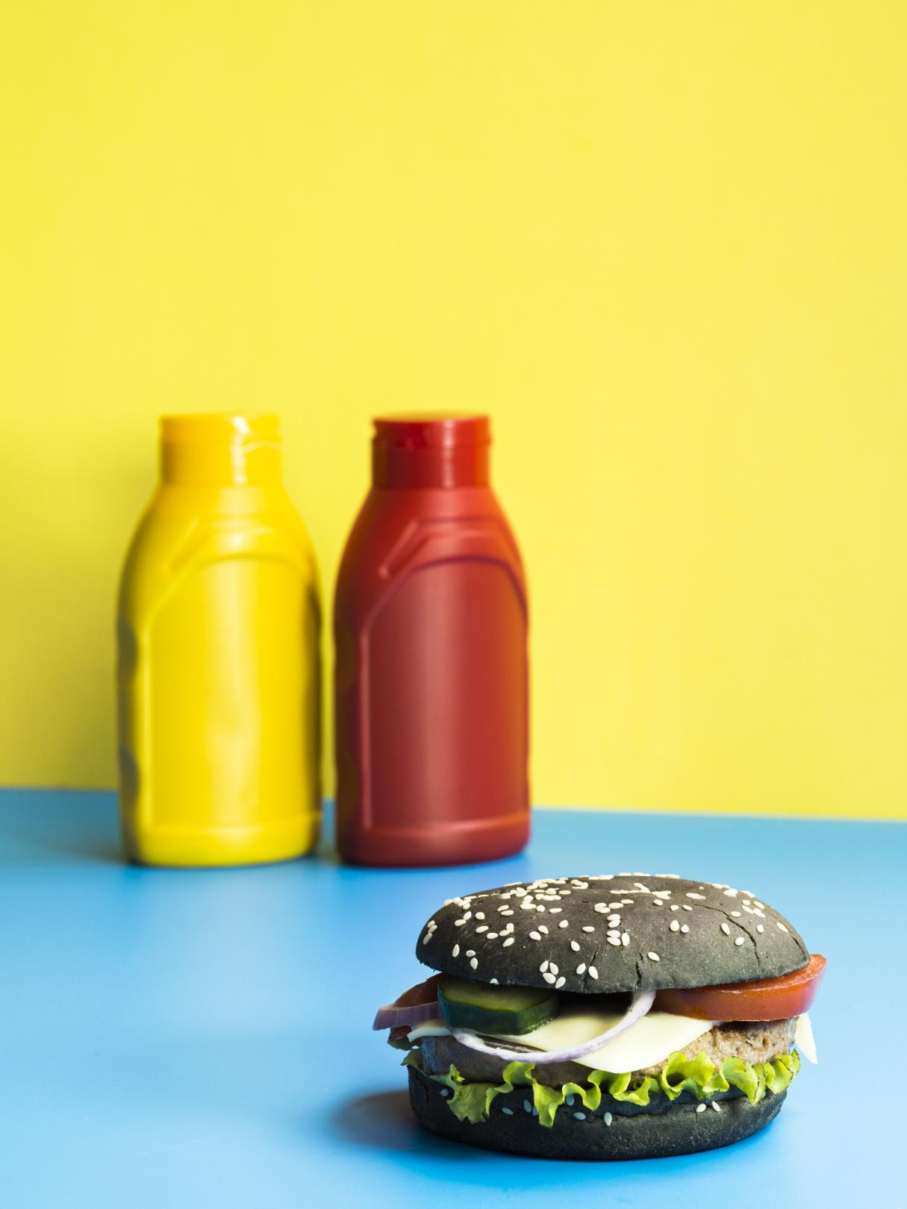


Food and Beverage Industry
CodeX
Indian Market Test Launch Sample Survey Analysis
by Princy J
2023

Slide 2

Contents
Objective
Data Model & Insight Queries
Overall Distribution
Primary Insights Analysis
Secondary Insights Analysis
Thanks Note
by Princy J
2023

Slide 3

Objective
To extract meaningful insights from the survey conducted by CodeX planning to establlish their Market presence in India
The suevey focused on the test launch of their energy drinks in 10 Indian cities, with the aim of enhancing brand awareness, capturing market share, and facilitating product developement
My objective is to analyse the processed survey results and derive valuable insights to support strtegic decision-making for CodeX
by Princy J
2023

Slide 4

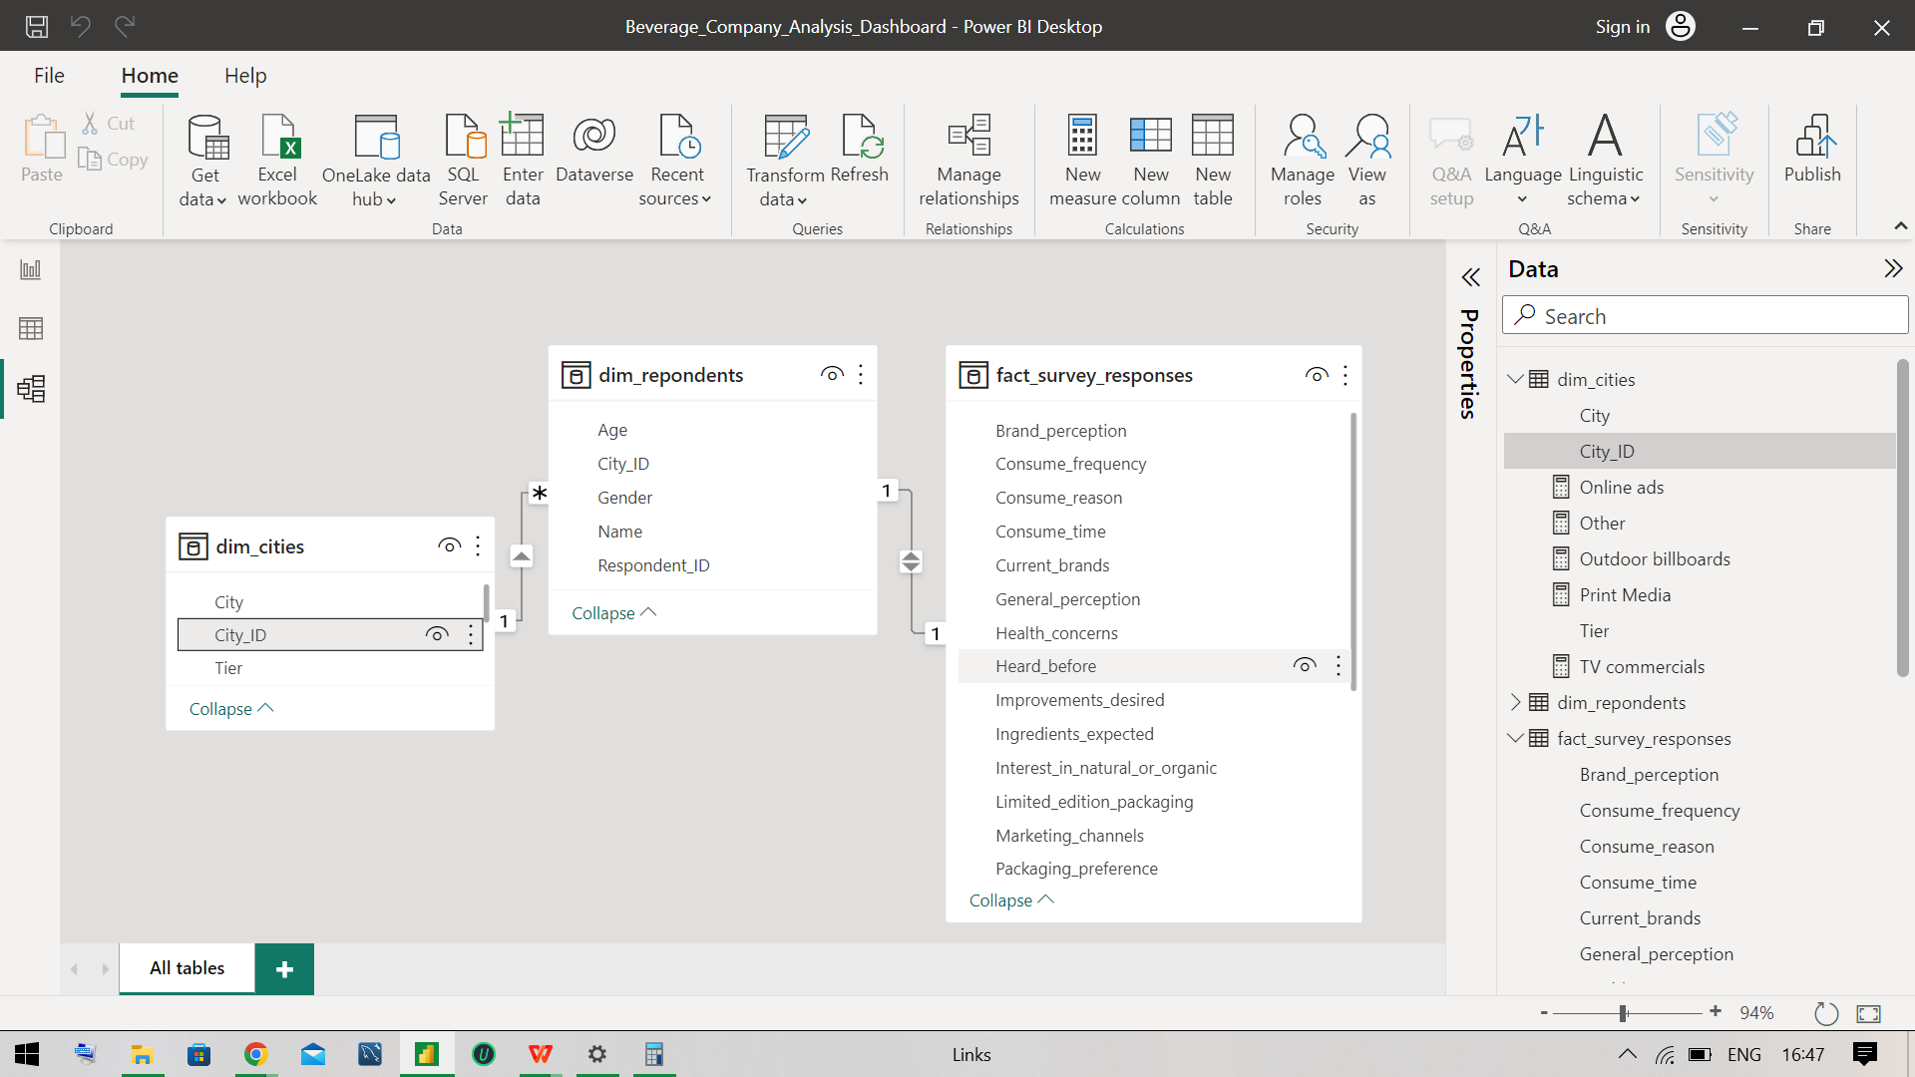
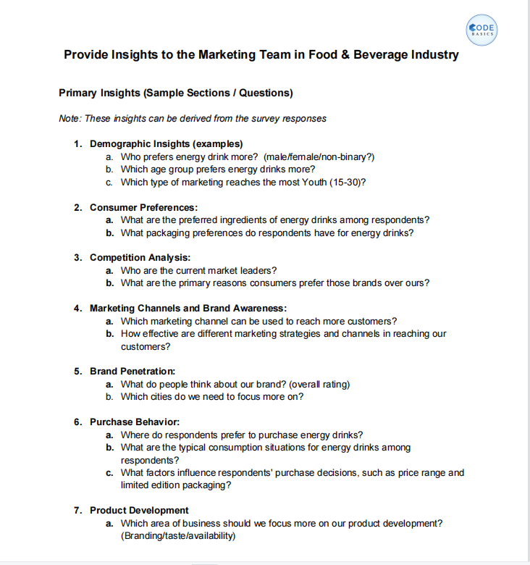
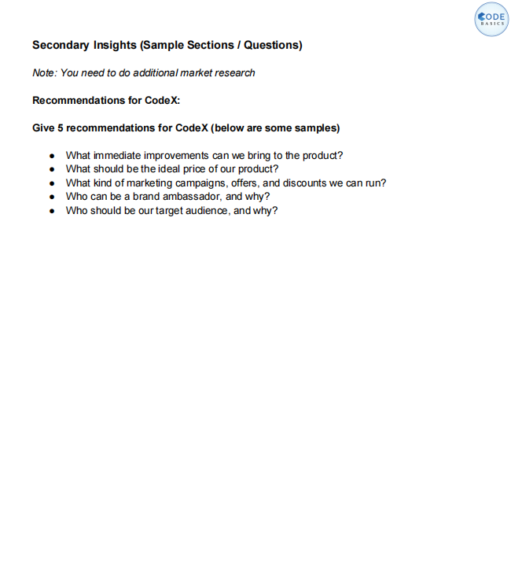
Data Model & Insight Queries
by Princy J
2023

Slide 5
Overall Distribution
Gender | Male | Female | Non-binary
 | 6038 | 3455 | 507
Age | 19-30 | 31-45 | 15-18 | 46-65 | 65+
 | 5520 | 2376 | 1488 | 426 | 190
Marketing Channel | Online ads | TV commercials | Outdoor billboards | Other | Print media
 | 4020 | 2688 | 1226 | 1225 | 841
General perception | Effective | Not sure | Healthy | Dangerous
 | 2909 | 2610 | 2243 | 2238
Brand perception | Neutral | Positive | Negative
 | 5974 | 2257 | 1769
Reason for choosing brand | Brand reputation | Taste/flavor preference | Availability | Effectiveness | Other
 | 2652 | 2011 | 1910 | 1748 | 1679
Reason preventing trying | Not available locally | Health concerns | Not interested in energy drinks | Brand Unfamiliarity | Other
 | 2431 | 2258 | 2193 | 1850 | 1268
Heard before | No | Yes
 | 5553 | 4447
by Princy J
2023

Slide 6
Continued....
Tried before | No | Yes
 | 5119 | 4881
Consume reason | Increased energy and focus | To combat fatigue | To enhance sports performance | To boost performance | Other
 | 3574 | 2428 | 1604 | 1514 | 880
Consume time | To stay awake during work/study | Before exercise | For mental alertness | Throughout the day
 | 3409 | 3148 | 1995 | 1448
Consume frequency | 2-3 times a week | Rarely | 2-3 times a month | Once a week | Daily
 | 3491 | 1941 | 1613 | 1609 | 1346
Typical consumption situation | Sports/exercise | Studying/working late | Social outings/parties | Other | Driving/commuting
 | 4494 | 3231 | 1487 | 491 | 297
Taste_experience | 3 | 4 | 5 | 2 | 1
 | 2957 | 2479 | 1986 | 1524 | 1054
Ingredients expected | Caffeine | Vitamins | Sugar | Guarana
 | 3896 | 2534 | 2017 | 1553
by Princy J
2023

Slide 7
Continued....
Improvements desired | Reduced sugar content | More natural ingredients | Wider range of flavors | Healthier alternatives | Other
 | 2995 | 2498 | 2037 | 1472 | 998
Packaging preference | Compact and portable cans | Innovative bottle design | Collectible packaging | Eco-friendly design | Other
 | 3984 | 3047 | 1501 | 983 | 485
Limited edition packaging | No | Yes | Not Sure
 | 4023 | 3946 | 2031
Interest in Natural or Organic | Yes | No | Not Sure
 | 4983 | 3062 | 1955
Health Concerns | Yes | No
 | 6045 | 3955
Price range | 50-99 | 100-150 | Above 150 | Below 50
 | 4288 | 3142 | 1561 | 1009
Purchase Location | Gyms and fitness centers | Local stores | Online retailers | Other | Supermarkets
 | 1464 | 813 | 2550 | 679 | 4494
by Princy J
2023

Slide 8
Continued....
Current Brands | Cola-Coka | Bepsi | Gangster | Blue Bull | Sky 9 | CodeX | Others
 | 2538 | 2112 | 1854 | 1058 | 979 | 980 | 479
City Tier | Tier 1 |  |  |  |  | Tier 2
 | 7537 |  |  |  |  | 2463
City | Bangalore | Hyderabad | Mumbai | Chennai | Pune | Kolkata | Ahmedabad | Delhi | Jaipur | Lucknow
 | 2828 | 1833 | 1510 | 937 | 906 | 566 | 456 | 429 | 360 | 175
Total number of respondents = 10000
Note: The forthcoming slides will talk about CodeX Insights as we have already analysed Overall survey distributions of all the brands
by Princy J
2023

Slide 9

DEMOGRAPHIC INSIGHTS
The Male category respondents prefers more energy drink of 590(60.20%) followed by female 352(35.92%) then non_binary 38(3.88%) category that too the male category of 19-30 age group consumes much which accounts 327(33.37%) in total respondents
Respondents age based energy drink preference distribution of CodeX goes like 19-30(540-55.10%)>31-45(242)>15-18(135)>46-65(37)>65+(26)
The Online ads of CodeX seems to reach most of the youth(15-30 age category) with a 34.38%(337) spread also reaches most of the male category, then TV Commercials, Outdoor billboards and other disributions are equal in spread, and then comes the print media
by Princy J
2023

Slide 10

Consumer preferences
Caffiene is the most preferred with 37%(363) followed by Vitamins 23%(243), Sugar 22%(219)and Gurana 16%(115) respondents
412(42%) of 980(100%) respondents chose Compact and portable cans, and 285(29%)-innovative bottle design, 130(13%)- collectible packaging, 105(11%)- Eco-friendly design and 48(5%) -other category respectively
by Princy J
2023

Slide 11

Competition Analysis
Cola-Coka is the leading brand with 2538(25.38%) of the respondents, followed by Bepsi with 2112(21.12%), Gangster with 1854(18.54%), BlueBull with 1058(10.58%), CodeX with 980(9.80%) at 5th place, Sky 9 with 979(9.79%), Other respondents 479(4.79) as per the survey of 10K respondents
Brand reputation chosen by 2652(26.52%) and the remaining reasons are taste/Flavour preference-20.11%, Availability-19.10%, Effectiveness-17.48% and other 16.79%
There is a twist in case of CodeX where taste/Flavour-18.57% is lesser than Availability-19.90% unlike the overall brand choice reasons spread
by Princy J
2023

Slide 12

Market channel & brand awareness
Online ads Marketing channels can be used to reach more customers since it captures 41.94% of respondents
In terms of comparison with the leading brand and also with rest of the marketing channels CodeX has acheived a 41.94% reach, which is the highest of all.
When we analyse the respondents who heard before about CodeX category with Marketing channels, respondents who heard through online ads 43.96% are way much higher.
by Princy J
2023

Slide 13
brand penetration
Brand Perception(Overall Rating) = Brand perception Index(BPI)
BPI is a weighted index that assigns importance weights to each brand perception dimension and calculates the weighted sum of the scores.
Weighted Score Total = Sum of the weighted scores for each category
Weighted Score = Percentage * Weight
Assigned weights: Negative-0.3; Neutral-0.5; Positive-0.7
BPI of CodeX is 0.17(16.99%) where the remaining brands also seems to have the same rating approximately, which shows that CodeX has relatively consistent perception among respondents
Brand Perception Index = Weighted Score Total / Number of Brand Perception Categories
Brand_perception | Count of Respondent_ID | Weight(assigned) | Rating(Weight*Percentage)
Negative | 17.55% | 0.3 | 0.05
Neutral | 60.10% | 0.5 | 0.30
Positive | 22.35% | 0.7 | 0.16
Grand Total | 100.00% | sum of rating = | 0.51
 |  | CodeX_Rating= | 0.17
by Princy J
2023

Slide 14
brand penetration
The Cities can be divided as:
Tier 1: Banglore(29.80%), Hyderabad(18.57%), Mumbai(15.92%), Chennai(9.39%), Delhi(4.08%)
Tier 2: Pune(9.39%), Kolkata(4.90%), Ahmedabad(4.59%), Jaipur(2.86%), Lucknow(0.51%)
The cities that need more focus on are Lucknow- 0.51%(175), Jaipur- 2.86%(360), Delhi- 4.08%(429), Ahmedabad- 4.59%(456) and Kolkata- 4.90%(566)
As we can see, there is Delhi with 4.08% from Tier 1 Cities that needs more focus on
From Tier 2 Cities Pune has more respondents with 9.39% in favor of CodeX
by Princy J
2023

Slide 15
Purchase behaviour
Purchase Location preferred: Supermarkets(44.49%)>Online retailers(25.31%)>Gym and Fitness Centers(14.59%)>Local stores(8.88%)>Other(6.73%)
Preferred Consumptions Situations: Sports/Excercise(45.92%)>Studying/Working late(32.65%)>Social Outings/Parties(13.06%)>Other(6.12%)>Driving/Commuting(2.24%)
by Princy J
2023

Slide 16
Purchase behaviour
Factors influencing Customers Purchase Decision:
The most chosen price ranges between 50-99 with 41.84% followed by 100-150(31.94%), Above 150(16.2%), Below 150(10%)
most people prefer limited edition pakaging(42.35%), people who dont demands(37.76%) and not sure(19.920%)
Consume reason with high response is Increase Energy & Focus(35.10%), followed by To combat fatigue(22.1%), To boost Performance(16.53%), To enhance sports performance(15.82% and the other(10.41%)
Consume Frequency: 2-3 times a week(36.84%); Rarely(20.82%); 2-3 times a month(15%); Once a week (14.80%); Daily(12.55%)
by Princy J
2023

Slide 17
Areas to focus
We should first know the comparisons over spread to find the area to develop
Branding: On comparing the CodeX perception it is clear that CodeX has balanced perceptions just like the lead brands and it can also be seen in Brand Choice reason spread still CodeX can focus more on branding to stand out from the other brands
Availability: Though One of the major reasons preventing customers from trying codeX is Non-Availability locally 23.7%(229), Codex has pretty good distributions in comparison with other brands
Taste:most of the respondents rated CodeX with 3(286), 4(248), 5(191), 2(148) and 1(107); The Brand choice reason spread is clearly showing that CodeX need to focus on Taste Improvisation
by Princy J
2023

Slide 18
Secondary Insights
Immediate improvements to be made:
The top two improvements desired by respondents are reduced sugar content (2995 respondents) and more natural ingredients (2498 respondents), followed by a wider range of flavors (2037 respondents) and healthier alternatives (1472 respondents). In addition, 998 respondents mentioned other suggestions.
Additionally, out of a total of 10,000 respondents:
6045 respondents have indicated that they are health concerned
3955 respondents have indicated that they are not health concerned
reducing sugar content and incorporating more natural ingredients are popular desires among the respondents
In terms of CodeX out of 980 respondents, 597 people are health concerned also more inclined towards reduced sugar content(30.41%) & Natural Ingredients(23.88%) along with wide range of flavors(21.22%) & Healthier alternatives(14.59%)
➢
by Princy J
2023

Slide 19
Secondary Insights
Ideal price of CodeX product
Ideal Price Calculation: The price range category is cross tabulated on City tier & Cities
The percentage of respondents from Tier 1 & Tier 2 cities based on their price range preference is listed
Check for outliers in the listed values, if found calculate median else calculate the average, we will get the following table
From the observations in both Tier 1 & Tier 2 Cities 100-150 & 50-99 seems to be the most chosen. the ideal range shall be 75-125 among different Tiers of the city
Tier 2 | 100-150 | 50-99 | above 150 | Below 150
 | 27.53% | 39.29% | 13.04% | 9.64%
Tier 1 | 100-150 | 50-99 | above 150 | Below 150
 | 31.85% | 41.30% | 15.93% | 9.84%
by Princy J
2023

Slide 20
Secondary Insights
Target Respondents & reason
CodeX Premium respondents:
on the categories of positive who responded with effective(55) and Healthy(45) in their general perception
respondents to be focused:
with general perception as Not Sure(62) and dangerous(57) but responded with a positive brand perception should be analysed in depth to know about the features that influenced them and enhance those features
Valuable respondents Category:
respondents of Neutral general perception and Effective(177)&Healthy(137) Brand perceptions
by Princy J
2023

Slide 21
Secondary Insights
Target Respondents & reason
(1) | (2) | (3) | (4) | (5)
55 | 57 | 177 | 54+38 | 40
45 | 62 | 137 | 117+158 | 40
100 | 119 | 314 | 367 | 80
Persuadable respondents Category:
respondents of Neutral Brand perception with Not sure(158) & dangerous(117) and Negative Brand perception with Effective(54) & Healthy(38) general perception
Disinteresd respondents Category:
respondents of Negative Brand perceoption with Not sure(40) & Dangerous(40) General perception
Brand_perception | Dangerous | Effective | Healthy | Not sure | Grand Total
Negative | 40 | 54 | 38 | 40 | 172
Neutral | 117 | 177 | 137 | 158 | 589
Positive | 57 | 55 | 45 | 62 | 219
Grand Total | 214 | 286 | 220 | 260 | 980
by Princy J
2023

Slide 22
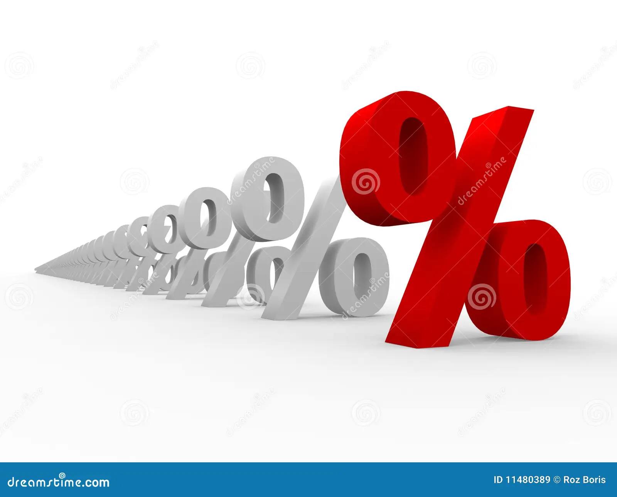
Secondary Insights
Market Campaign, Offers & Discounts
Marketing Campaigns: Campaigns can be focussed more on the most reachable plaatform rather than utilising resources to all areas
Online ads: increase more advertisements, use retargeting & Personalized ads, adapt influencer marketing, Social media campaign can help in reaching desired audience of specific age group, location and interests
TV Commercials: A wide range of audience can be reached out.
Outdoor billboards: Increase brand visibilty in high traffic areas
Print media: A detailed information can be relayed to a specific set of targeted audience
Offers & Discounts:
Limited Edition Packaging: Introduce limited edition packaging to create a sense of exclusivity and attract customers.
Price Range: Consider offering competitive pricing within the preferred price range of 75-125 to attract more customers.
Purchase Location: Collaborate with supermarkets and online retailers to provide exclusive discounts or bundle offers.
by Princy J
2023

Slide 23

Secondary Insights
Brand Ambassador
Divya: Divya, being a frequent consumer and falling within the target age group, can be a potential brand ambassador. She can promote the product's effectiveness and energy-boosting benefits as she is an athlete & fit in nature hence she can also promote the impact of the drink in sports & Excercise
Vineeth: Vineeth is a regular customer, He is academically outstanding hence he can emphasize the drink’s effect on staying awake during work & Study and can also help in promoting the drink for aiding in combating fatigue
by Princy J
2023

Slide 24
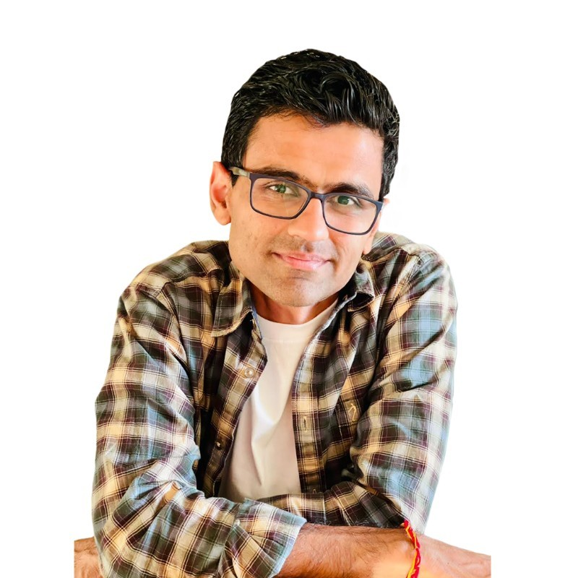

Thanks to...
In my journey as a self-learner data enthusiast, I am immensely grateful for the invaluable classes and guidance I received from codebasics. I want to express my sincere appreciation for organizing the resume hiring challenge, as it has been an instrumental tool in enhancing my skills and knowledge.
Mr.Dhaval Patel
Mr.Hemanand Vadivel
by Princy J
2023

